Slide 1
Genetic Variation and Transcriptional Regulation
BIOM262 - Quantitative Methods in Genetics and Genomics
Graham McVicker – Salk Institute
Notes:
I moved to San Diego and started my lab at the Salk Institute in January of this year. I’m very happy to have this opportunity today to come and speak at UCLA and meet with some colleagues in Southern California.

Slide 2
Overview
Today:
Introduction to human genetics, quantitative traits, and genomewide association studies
Thursday:
Mapping molecular quantitative trait loci

Slide 3
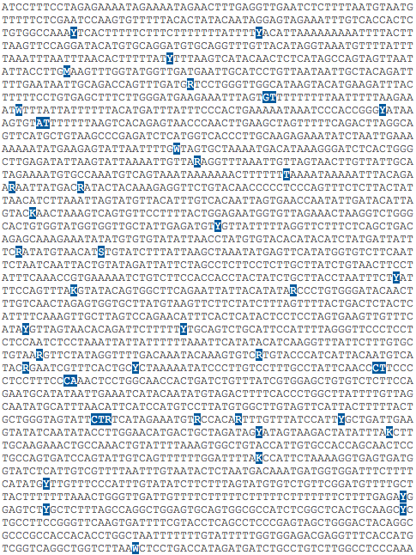


Which genetic variants affect human traits?
?
Notes:
Ideally we would like to be able to look at a set of sequence variants like these and pick out the ones that affect a particular human trait. For example, which, if any, of these genetic variants affect human height? Once we know which genetic variants are functional, how do we discover their mechanism of action?

Slide 4
Ankylosing Spondylitis
Alzheimer’s Disease
Leukemia
Multiple Sclerosis
Psoriasis
Breast Cancer
Schizophrenia
Rheumatoid Arthritis
Coronary Heart Disease
Celiac Disease
Autism
Crohn’s Disease
Parkinson’s Disease
Type I Diabetes
Systemic Lupus Erythematosus
Notes:
In addition to defining the features that make each of us unique, genetic variation also has important medical consequences. Many genetic variants influence disease risk. Shown here are just a few of the common diseases that have important genetic components.
If we want to understand the causes of these diseases and ultimately how to treat them it’s really important to understand how genetic variation leads to disease risk is important

Slide 5
Notes:
Yet even when we have a comprehensive catalog of human genetic variation, determining which genetic variants are functional is extremely difficult. This is a picture of known genetic variants in a single region of the genome. Without additional information, there is no way to tell which of these variants have meaningful biological functions. And this is very small region of the genome. The haploid human genome contains over 3 billion bases and each of us carries millions of genetic variants. Only a subset which affect human traits.

Slide 6
Topics
Genome-wide association studies
Molecular quantitative trait loci (QTLs)
Gene expression QTLs
Chromatin QTLs
DNA methylation QTLs
Intersection of molecular QTLs and GWAS

Slide 7

Testing for genetic association
TTGTTAGAGGTTTAAATT
G
G
TTGTTAGAGGTTTAAATT
TTGTTAGAGGTTTAAATT
G
A
TTGTTAAAGGTTTAAATT
TTGTTAAAGGTTTAAATT
A
A
TTGTTAAAGGTTTAAATT
Notes:
An approach that has been used successfully is to perform a test for genetic association. You can taka look at a single genetic variant and ask if the genotype of that variant is associated with a trait of interest.
In this cartoon I am grouping individuals by whether they have 2 copies of the G allele, 2 copies of the A allele, or one copy of each allele. And you can see that there is a clear association between genotype and height.

Slide 8
Case-Control Association Study
Cases
Controls
AA
AG
GG
Genotype

Slide 9
Case-Control Association Study
 | # A alleles | # B alleles
Cases | 750 | 250
Controls | 800 | 200
χ² p-value = 0.009

Slide 10
Quantitative Trait Association Study
Trait Measurement
AA
AG
GG
Genotype

Slide 11
Discussion
What are examples of human traits?
Quantitative Traits?
Binary (Case/Control) Traits?

Slide 12
In class exercise
GWAS study results from Rheumatoid Arthritis (Okada et al. 2014)
Meta-analysis of European and Asian individuals
29,880 RA cases and 73,758 controls
~10 million SNPs tested
Datafile: RA_GWAS.txt (reduced to random set of 100k SNPs)

Slide 13
Exercise
Read RA_GWAS.txt table into R
Make a histogram of the p-values

Slide 14
P-value distribution
Notes:
# notice that the distribution looks faily uniform, but with an excess of low p-values

Slide 15
Exercise
Make a quantile-quantile plot of -log10 expected vs. observed p-values
Expected p-values are uniformly distributed
Notes:
## Quantile-quantile plot is used to compare
## two distributions. Under the null hypothesis, p-values should be uniformly distributed
# we can use a qq-plot to compare the observed p-values to what would be expected# under the null

Slide 16
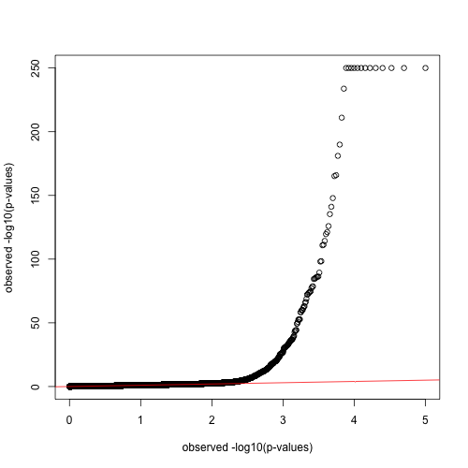
P-value QQPlot
-log10(observed P-values)
-log10(expected P-values)
Notes:
## Quantile-quantile plot is used to compare
## two distributions. Under the null hypothesis, p-values should be uniformly distributed
# we can use a qq-plot to compare the observed p-values to what would be expected# under the null
# add a line with a slope of 1, to show what the p-values would look# like if the followed the null distributionabline(a=0, b=1, col="red")

Slide 17
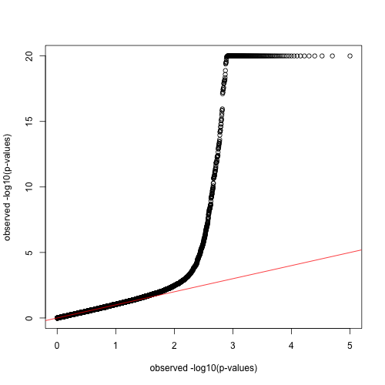
truncated -log10 P-value QQPlot
-log10(observed P-values)
-log10(expected P-values)
Notes:
## there are some very low p-values that make it difficult
## to see the relationship between the two distributions,## so threshold p-values below 1e-20 to 1e-20

Slide 18
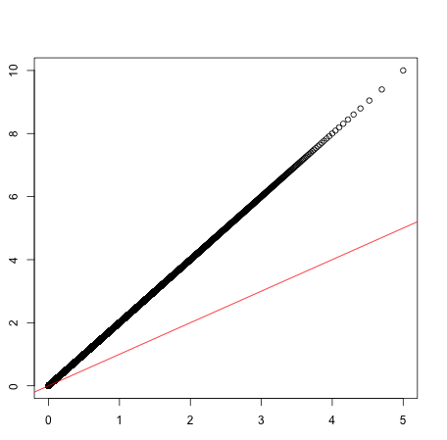
example of deflated p-values
-log10(observed P-values)
-log10(expected P-values)
Notes:
## there are some very low p-values that make it difficult
## to see the relationship between the two distributions,## so threshold p-values below 1e-20 to 1e-20

Slide 19
Discussion
What can cause ”deflated” p-values?
Inflated p-values?
What other information can QQPlot of –log10 P-values provide?

Slide 20
Exercise
Make a “manhattan” plot with SNP genome position on X-axis, -log10 p-values on Y-axis
Try to make neighboring chromosomes different colors
Notes:
## Quantile-quantile plot is used to compare
## two distributions. Under the null hypothesis, p-values should be uniformly distributed
# we can use a qq-plot to compare the observed p-values to what would be expected# under the null

Slide 21
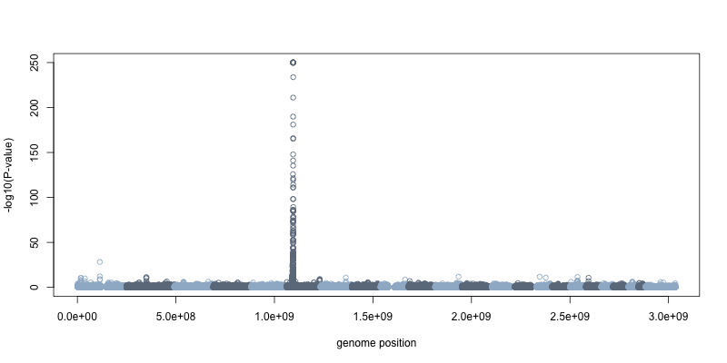
What region is this signal from?
-log10(P-value)
genome position

Slide 22
Exercise
What SNP is giving the lowest p-value?
What gene(s) are in this region (look up in genome browser)
Notes:
## Quantile-quantile plot is used to compare
## two distributions. Under the null hypothesis, p-values should be uniformly distributed
# we can use a qq-plot to compare the observed p-values to what would be expected# under the null

Slide 23
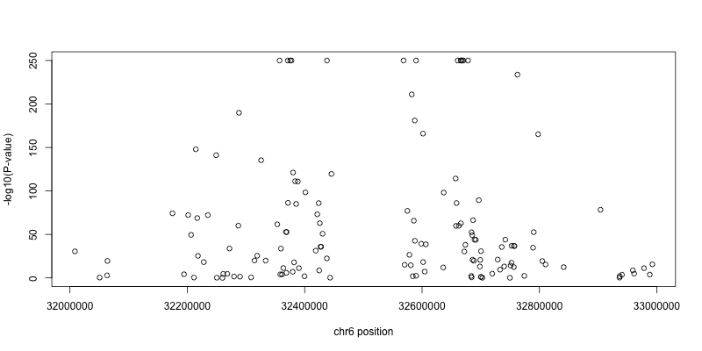

Slide 24
Why do so many SNPs in this region have low P-values?

Slide 25
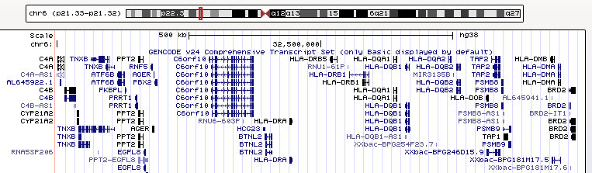
MHC Class 2

Slide 26
Exercise
What about outside of the MHC region?
remake manhatten plot, but threshold low p-values to 1e-20
Draw a line indicating genome-wide significance at p=5e-8
Roughly how many significant hits are there?
Notes:
## Quantile-quantile plot is used to compare
## two distributions. Under the null hypothesis, p-values should be uniformly distributed
# we can use a qq-plot to compare the observed p-values to what would be expected# under the null

Slide 27
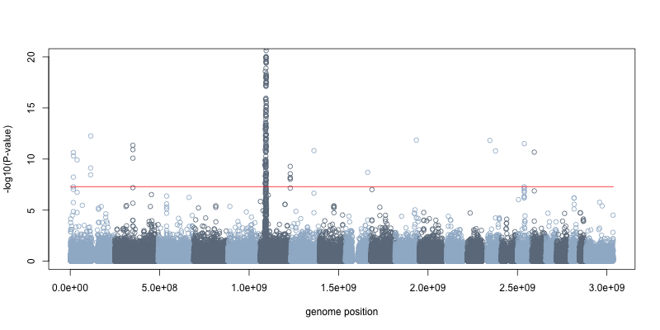

Slide 28
Discussion
Why use 5e-8 as a threshold for genome-wide significance?
Why not simply correct for the number of SNPs tested?

Slide 29
Wellcome Trust Case Control Study
14,000 cases for 7 diseases
3,000 shared controls
Rheumatoid Arthritis
Observed test statistic
Expected test statistic
WTCCC 2007

Slide 30
Bipolar Disorder
Coronary Artery Disease
Crohn’s Disease
Hypertension
Rheumatoid Arthritis
Type 1 Diabetes
Type 2 Diabetes
WTCCC 2007

Slide 31
Manhattan Plot of Association Signals
Rheumatoid Arthritis
-log10(P-value)
Chromosome Position
WTCCC 2007

Slide 32
WTCCC 2007

Slide 33
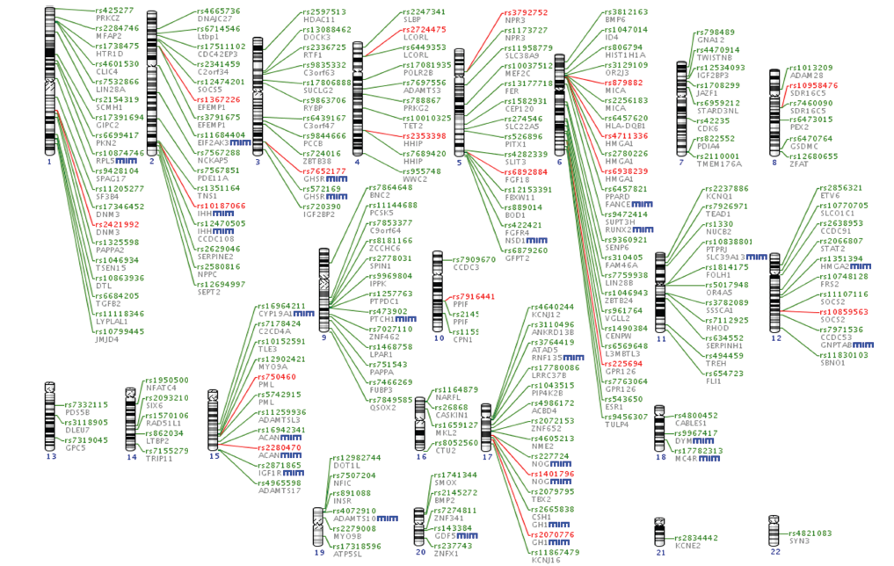
QTLs for human height
Lango-Allen et al. 2010
Notes:
With human traits, things get a bit more complicated still. Most traits are highly polygenic, which means that there are many genes that affect them.
Here I’m showing results from a genome-wide association test for height that was performed on 183,000 individuals. In this study they found 199 genes that are associated with human height. It is likely that there are hundreds more genes that contribute to this trait, but incredibly large sample sizes are needed to discover them.

Slide 34
Crohn’s Disease Hit Region, Chromosome 3
WTCCC 2007

Slide 35
Discussion
What are advantages of GWAS over candidate gene studies?
What are some disadvantages / limitations of GWAS?

Slide 36
Difficulty in interpreting GWAS hits
Most associated variants (hits) are far from known genes
Which gene(s) do they effect?
What is their function / mechanism?
What cell types are the variants active in?
Which variants are causal?

Slide 37
Molecular traits as an intermediate phenotype
GG
GA
AA
Notes:
So a different approach is needed to go after functional variants, particularly those outside of coding regions.
One approach that I am going to focus on today, is to measure traits such as gene expression at a molecular level and to treat these molecular traits as a phenotype. We can identify genetic variants associated with these molecular traits and start to bridge the gap with higher level phenotypes.
One of the primary aims of my research is to start making connections like these: to identify genetic variants that affect molecular traits, and then to link them to higher-level human phenotypes.

Slide 38
Why use molecular traits?
Close to underlying genetics
affected by small number of polymorphisms
require smaller sample sizes
Can measure 1000s of traits in single experiment (e.g. RNA-seq)
Reveal molecular basis of organismal traits
implicate specific cell types

Slide 39
Discussion
What else could be used as molecular or cellular traits?
How would you measure these?

Slide 40
The first gene expression QTL mapping study
RM
BY
Cross two diverged yeast
strains “RM” and “BY”
X
meiosis
Measure Gene Expression
with microarrays
Genotype “segregants”
to identify parental genome
segments
Brem et al. 2002

Slide 41
Quantitative Trait Locus Mapping with recombinant inbred lines
Lango-Allen et al. 2010

Slide 42
A yeast eQTL
Brem et al. 2002

Slide 43
eQTL mapping in humans
Gene expression
AA
AG
GG
Genotype

Slide 44
Pedigree-based mapping of eQTLs in human B cell lines
Morley et al. 2004

Slide 45
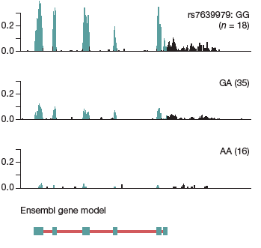
eQTL mapping with RNA-seq
GG
(n=18)
GA
(n=35)
RNA-seq read depth (reads per million)
AA
(n=16)
TSP50
Pickrell et al. 2010
Notes:
Here is an example of using gene expression as a molecular trait published by the Pritchard and Gilad labs.
They looked at 70 lymphoblastoid cell lines, and treated gene expression as a quantitative trait.
They identified genetic associations with gene expression, which are known as eQTLs.
Here is an example of an eQTL for the gene TSP50. Individuals with the GG genotype have the highest expression, heterozygus individuals have intermediate expression and individuals with the AA genotype have the lowest expression

Slide 46
Splicing QTLs (sQTLs)
Pickrell et al. 2010

Slide 47
eQTLs are enriched near transcription start sites
Battle et al. 2014

Slide 48
eQTLs are enriched in regions with open/active chromatin
Gaffney et al. 2012

Slide 49
Distance from TSS and DNase sensitivity are predictive of eQTLs
Gaffney et al. 2012

Slide 50
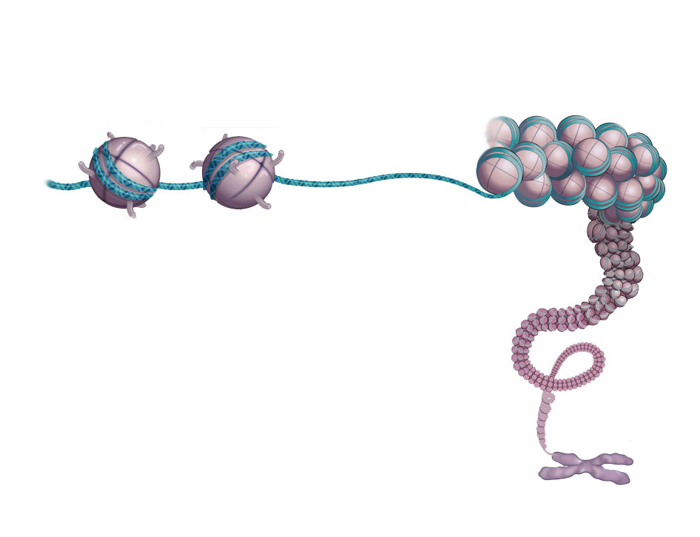
Chromatin as a molecular trait
Histone
Nucleosome
DNA
chromosome
Ecker et al. 2012
Notes:
IN the nucleus of our cells, our genome doesn’t simply exist as naked DNA
rather it is bundled up into a protein-DNA complex, which is known as chromatin
at the lowest level chromatin consists of a set of nucleosome cores, that resemble beads on a string.
Each nucleosomes core is made up of an octamer of histone proteins, encircled by 147 basepairs of DNA

Slide 51
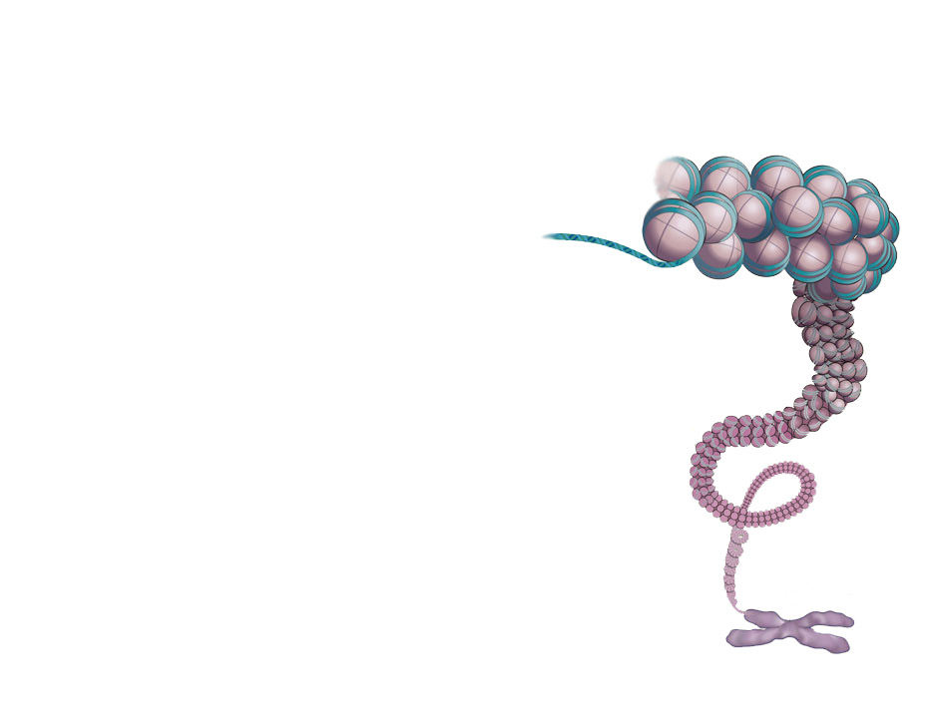
Discussion
What aspects of chromatin could be treated as a molecular trait?
Do these traits have discrete or continuous values?
Notes:
- For the remainder of my talk I will discuss molecular phenotypes that are related to chromatin.
- I will first give some background on chromatin and then discuss several aspects chromatin that can be used as a quantitative trait
- I will then discuss new methods that I developed for mapping molecular QTLs and how I applied these methods to identify histone modification QTLs.

Slide 52
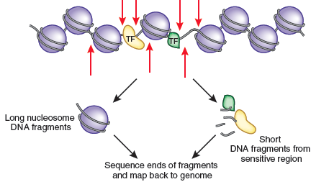
Nucleosomes are depleted in regulatory regions
Raj & McVicker 2013
Notes:
Importantly, regulatory sequences of the genome are typically depleted of nucleosomes. This cartoon shows two transcription factors, which are bound to regulatory regions where the nucleosomes have been displaced. This is typical of most active regulatory regions of the genome, so if you can identified nucleosome depleted regions you can identify many of the active regulatory regions in the genome

Slide 53
Measuring chromatin accessibility with DNase-seq
digest chromatin with Deoxyribonuclease 1 (DNase1)
Notes:
One way to measure nucleosome depleted sequences is to use an enzyme known as DNase I, which preferentially digests nucleosome free regions.

Slide 54
Measuring chromatin accessibility with DNase-seq
isolate short sequence fragments
Notes:
We can digest chromatin using DNase and isolate short sequence fragments that result from this digestion

Slide 55
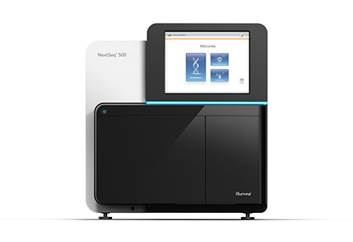
Measuring chromatin accessibility with DNase-seq
sequence
DNA fragments
TTGTTAAGGTTTATGTTCGTTTAATGGTG
TTTCTTACGACTGTACGATCAAAACGGGG
AGGCGGCAAGCAGGTGCAGCGTTTTTATA
GGGCTACAACACGTTGGTGCACCCAACAC
Notes:
We can then sequence these short sequence fragments

Slide 56
Measuring chromatin accessibility with DNase-seq
map to genome
GTTCGTTTAATGGTGGCCGGAGGG
TTGTTAAGGTTTATGTTCGTTTAATGGTG
GTTTATGTTCGTTTAATGGTGCCG
TTTCTTACGACTGTACGATCAAAACGGGG
GTTTATGTTCGTTTAATGGTGCCG
AAGGTTTATGTTCGTTTAATGGTG
TTGTTAAGGTTTATGTTCGTTTAA
AGGCGGCAAGCAGGTGCAGCGTTTTTATA
...ACCATTGTTAAGGTTTATGTTCGTTTAATGGTGCCGGGAGGGATTTA...
GGGCTACAACACGTTGGTGCACCCAACAC
Notes:
Map the sequences to the genome

Slide 57
Measuring chromatin accessibility with DNase-seq
DNase hypersensitive sites
TTGTTAAGGTTTATGTTCGTTTAATGGTG
TTTCTTACGACTGTACGATCAAAACGGGG
AGGCGGCAAGCAGGTGCAGCGTTTTTATA
GGGCTACAACACGTTGGTGCACCCAACAC
Notes:
And then identify peak regions with a high density of mapped reads. These are regions are known as DNase-hypersensitive sites, and correspond to active regulatory sequences that are depleted of nucleosomes.

Slide 58
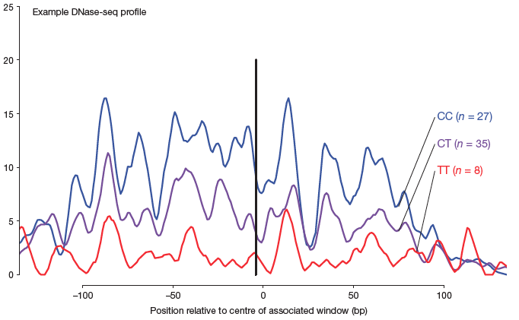
DNase sensitivity as a quantitative trait
25
CC (n=27)
DNaseI sensitivity
CT (n=35)
TT (n=8)
0
-100bp
-50bp
0
+50bp
+100bp
distance from center of DNase peak
Degner et al. 2012
Notes:
If we can measure DNase sensitivity in many individuals we can now treat it as a molecular trait.
This is a figure from a paper from the Pritchard and Gilad labs where they measured DNase 1 sensitivity in 70 cell lines
They identified genetic associations with DNase sensitivity which they named dsQTLs for DNase sensitivity quantitative trait loci
This is one example of a region surrounding a dsQTL, where the black line indicates the location of the associated polymorphism.
Surrounding the polymorphism there is a clear difference in DNase sensitivity between different genotypes

Slide 59
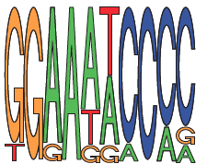
DNase sensitivity as a quantitative trait
25
CC (n=27)
DNaseI sensitivity
CT (n=35)
TT (n=8)
0
-100bp
-50bp
0
+50bp
+100bp
T/C
NF-κB motif
Degner et al. 2012
Notes:
Interestingly, the polymorphism falls within a binding site and disrupts the binding motif for the transcription factor NFkB
This suggests that the binding of this transcription factor might be important for the chromatin accessibility of this region.

Slide 60
Determining nucleosome positions with MNase-seq
digest chromatin with micrococcal nuclease (MNase)
Notes:
Another assay that can be used to examine chromatin is MNase-seq.
MNase is like DNase, in that it digests DNA. It preferentially digests linker regions between nucleosomes, not just the nucleosome depleted regions that are accessibly to DNase.

Slide 61
Determining nucleosome positions with MNase-seq
isolate nucleosome-sized fragments and sequence ends
Notes:
After digesting chromatin with MNase, fragments of DNA that were wrapped around the nucleosomes can be isolated and their ends can be sequenced.

Slide 62
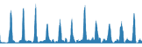
Determining nucleosome positions with MNase-seq
peaks are consistently-positioned nucleosomes
Notes:
We can then mapped the sequenced DNA fragments back to the genome to determine the positions of nucleosomes on the genome.

Slide 63
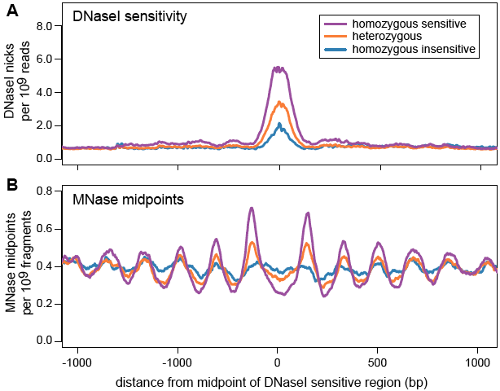
dsQTLs are associated with nucleosome positions
DNase I sensitivity
homozygous
high sensitivity
DNase reads (FPKM)
heterozygous
homozygous
low sensitivity
-1000
-500
0
+500
+1000
Distance from midpoint of sensitive site (bp)
Gaffney*, McVicker* et al. 2012
Notes:
In collaboration with the Gilad lab, I conducted a study in which we collected MNase-seq data from 7 lymphoblastoid cell lines.
We then used these data to determine the positions of nucleosomes in these cells.
One question we can ask with these data are whether genetic variants that affect DNase sensitivity also affect the positioning of nearby nucleosomes.
Here I’m showing you mean DNase1 sensitivity, aggregated across all dsQTLs that were identified in 70 cell lines. You can see that there is the expected association between genotype and DNase1 sensitivity.
The bottom plot shows the nucleosome positions grouped into the same genotype classes as the dsQTLs. In the high-sensitivity genotype the nucleosomes have very consistent positions and are organized into regularly spaced arrays surrounding the DNase hypersensitive site. In the low-sensitivity genotype class the nucleosome positions have shifted and are much less consistent between regions. This shows that genetic variation that affects DNase sensitivity also affects the positions of flanking nucleosomes.

Slide 64
dsQTLs are associated with nucleosome positions
DNase I sensitivity
homozygous
high sensitivity
DNase reads (FPKM)
heterozygous
homozygous
low sensitivity
nucleosome positions
MNase reads (FPKM)
-1000
-500
0
+500
+1000
Distance from midpoint of sensitive site (bp)
Gaffney*, McVicker* et al. 2012
Notes:
We can now look at how nucleosomes are positioned around these same DNase hypersensitive sites.
The bottom plot shows the nucleosome positions grouped into the same genotype classes as the dsQTLs. In the high-sensitivity genotype the nucleosomes have very consistent positions and are organized into regularly spaced arrays surrounding the DNase hypersensitive site. In the low-sensitivity genotype class the nucleosome positions have shifted and are much less consistent between regions. This shows that genetic variation that affects DNase sensitivity also affects the positions of flanking nucleosomes.

Slide 65
Histone modifications
H3K4me1: active/open chromatin outside of promoters
H3K4me3: active promoters
H3K27ac: active promoters & enhancers
H3K27me3: silenced genes
Notes:
Histone proteins may be chemically modified by enzymes within the cell. For example, the tails of the histone proteins can be modified by the addition of methyl or acetyl groups.
What’s interesting about these chemical modifications is that they are correlated with the function of the genome sequence.
So the presence or absence of particular histone modifications can be used to learn something about what the DNA sequence is doing
For example H3 Lysine 4 tri-methylation is found around the promoter regions of genes that are being actively expressed

Slide 66
Measuring histone marks with ChIP-seq
Notes:
The genomic locations of nucleosomes with different modifications can be determined with ChIP-seq experiments.
In this example, nucleosomes that have a trimethylated histone 3, lysine 4 residue are pulled down using an antibody that is specific to this modification.
The ends of the DNA fragments that are wrapped around these nucleosomes can then be sequenced and mapped back to the genome to determine where histones with this modification are located in the genome.

Slide 67
Measuring histone marks with ChIP-seq
Chromatin
Immunoprecipitation
(ChIP)
Notes:
We can measure the genomic locations of genes with
The genomic locations of nucleosomes with different modifications can be determined with ChIP-seq experiments.
In this example, nucleosomes that have a trimethylated histone 3, lysine 4 residue are pulled down using an antibody that is specific to this modification.
The ends of the DNA fragments that are wrapped around these nucleosomes can then be sequenced and mapped back to the genome to determine where histones with this modification are located in the genome.

Slide 68
Measuring histone marks with ChIP-seq
High-throughput
DNA sequencing
TTGTTAAGGTTTATGTTCGTTTAATGGTG
TTTCTTACGACTGTACGATCAAAACGGGG
AGGCGGCAAGCAGGTGCAGCGTTTTTATA
GGGCTACAACACGTTGGTGCACCCAACAC
Notes:
The ends of the DNA fragments that are wrapped around these nucleosomes can then be sequenced using high-throughput sequencing technology

Slide 69
Measuring histone marks with ChIP-seq
Map reads to
genome
TTGTTAAGGTTTATGTTCGTTTAATGGTG
TTTCTTACGACTGTACGATCAAAACGGGG
GTTCGTTTAATGGTGGCCGGAGGG
GTTTATGTTCGTTTAATGGTGCCG
AGGCGGCAAGCAGGTGCAGCGTTTTTATA
GTTTATGTTCGTTTAATGGTGCCG
AAGGTTTATGTTCGTTTAATGGTG
GGGCTACAACACGTTGGTGCACCCAACAC
TTGTTAAGGTTTATGTTCGTTTAA
...ACCATTGTTAAGGTTTATGTTCGTTTAATGGTGCCGGGAGGGATTTA...
Notes:
And mapped to the reference genome

Slide 70

Measuring histone marks with ChIP-seq
Identify ChIP-seq peaks
TTGTTAAGGTTTATGTTCGTTTAATGGTG
TTTCTTACGACTGTACGATCAAAACGGGG
AGGCGGCAAGCAGGTGCAGCGTTTTTATA
GGGCTACAACACGTTGGTGCACCCAACAC
Notes:
To determine the location of nucleosomes with these histone modifications we can then look for where a lot of reads map, or in other words ChIP-seq peaks.

Slide 71
ChIP-seq data from 10 individuals
H3K4me1
H3K4me3
H3K27ac
H3K27me3
Notes:
We performed ChIP-seq experiments on cells derived from 10 individuals
While 10 individuals may not sound like a lot
In total these experiments generated 4.4billion sequence reads
Or roughly 132GB of data
Because these same individuals have been used in other studies we also have RNA-seq data and complete genotype information for them

Slide 72
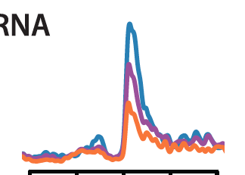
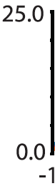
Are eQTLs also associated with histone modifications?
homozygous
high expression
25.0
RNA-seq
heterozygous
RNA-seq FPKM
homozygous
low expression
0.0
-1.0
0.0
+1.0
distance from TSS (kb)
Notes:
The first question that we can ask with these data are whether other molecular traits are also associated with differences in histone modification.
This figure shows aggregate RNA-seq read depth at the Transcription Start Sites that are associated with known gene expression QTLs or eQTLs.
The different colors show the mean read depth for each genotype class.

Slide 73
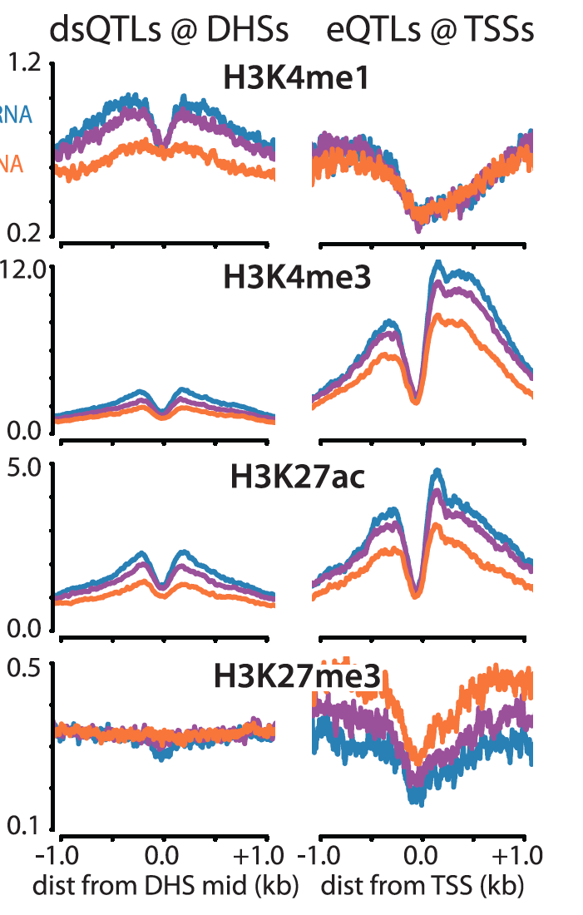
Are eQTLs also associated with histone modifications?
H3K4me1
H3K27ac
homozygous
high expression
FPKM
heterozygous
FPKM
homozygous
low expression
H3K4me3
H3K27me3
FPKM
FPKM
-1.0
0.0
+1.0
-1.0
0.0
+1.0
distance from TSS (kb)
distance from TSS (kb)
McVicker*, van de Geijn* et al. 2013
Notes:
I made similar plots for each of the 4 histone modifications around the same transcription start sites, and calculating mean read depth for each of the eQTL genotypes.
There is no difference in H3K4me1, but this mark is typically found outside of promoter regions.
The two marks associated with active promoters, H3K4me1 and H3K27ac, have the highest level for the high expression genotype, and the lowest levels in the low expression genotype.
This trend is reversed for the repressive mark H3K27me3, which has its highest level in the genotype class with the lowest expression.

Slide 74
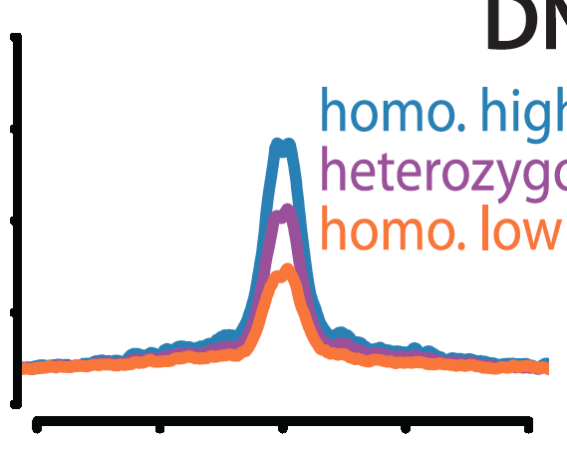
Are dsQTLs also associated with histone modifications?
homozygous
high DNase sensitivity
8.0
DNase-seq
heterozygous
DNase-seq FPKM
homozygous
low DNase sensitivity
0.0
-1.0
0.0
+1.0
distance from DHS (kb)
Notes:
I also looked at dsQTLs, which are sites with a known association between genotype and chromatin accessibility as measured by sensitivity to DNase1.

Slide 75
Are dsQTLs also associated with histone modifications?
H3K4me1
H3K27ac
homozygous
high sensitivity
FPKM
heterozygous
FPKM
homozygous
low sensitivity
H3K4me3
H3K27me3
FPKM
FPKM
-1.0
0.0
+1.0
-1.0
0.0
+1.0
distance from TSS (kb)
distance from TSS (kb)
McVicker*, van de Geijn* et al. 2013
Notes:
Histone marks around dsQTLs are also associated with the genotype of the dsQTLs.
H3K4me1 and H3K27ac are both elevated in the individuals with the high sensitivity genotype.
The levels of H3K4me3 are not as high around dsQTLs, because most of them lie outside of promoter regions, where this mark is found.
These results and those from the eQTLs, show that genetic variants associated with one molecular trait, such as gene expression or DNase1 sensitivity often affect other molecular traits as well. This is evidence that genetic variants often drive coordinated changes in multiple molecular phenotypes.

Slide 76
Can we identify Histone Mark QTLs?
A / G
Notes:
We want to know if we can use the Chip-Seq data from these experiments and treat Histone modifications as a molecular trait.
Is it possible to identify histone modification QTLs
ut is it possible to identify histone mark QTLs with only 10 samples for each histone modification?
To test this, we can take a standard approach to QTL mapping. We can identify SNPs that are within, or near to, ChIP-seq peaks, and test whether the SNPs, genotype is associated with the read depth of the peak.
Here is an cartoon example, where we are testing whether there is an association between read depth and the genotype of a SNP using a simple linear model.

Slide 77
Combined Haplotype Test
Notes:
So using a standard linear regression approach is hopeless with only 10 individuals.
But perhaps we can do better by exploiting some other features of the data.
I am going to describe a software package that we have developed that we call WASP.
WASP has two parts. The first part is a new statistical test for QTL discovery that we call the Combined Haplotype Test
The second part is a new method for correcting for bias in read mapping when working with allele-specific reads.
WASP is available for free on github and we would love to have more people try it out.

Slide 78
Read Depth Association Test
Read Depth
AA
AG
GG
Genotype
Model read counts with Poisson distribution:
λ =
2α
α+β
2β
Notes:
I will start by describing how the Combined Haplotype Test works.
As a first step, we can again use ChIP-seq read depth information, but instead of performing a standard linear regression we can model the read count data using the Poisson family of distributions. This more accurate models the variation that is present in the data, particularly if the number of counts is fairly small.

Slide 79
Allelic Imbalance Test
Reads with
reference allele
A
G
Reads with
non-reference allele
Model reference proportion with binomial distribution:
α
p =
α+β
Notes:
With sequencing reads, we can also perform a different type of test that uses another type of information: allele-specific reads.
When reads overlap a heterozygous SNP they can be assigned to one chromosome or another, by looking at the base that is present in the read. We can then test whether these reads are imbalanced, that is whether they come from one chromosome more often than the other, using a binomial test.

Slide 80
Haplotype Imbalance Test
A
G
A
G
T
C
Phase SNPs
Test allelic imbalance across entire haplotype
Notes:
Since we also have phasing information for SNPs, we know which alleles come together on the same chromosome. We can then test for allelic imbalance at all nearby heterozygous SNPs on the same haplotype.

Slide 81
Combined Haplotype Test
Read Depth Association Test
Haplotype
Imbalance Test
2α
if homozygous AA
+
α
p =
λ =
α+β
if heterozygous AB
α+β
2β
if homozygous BB
null hypothesis, H₀: α = β
alternative hypothesis, H₁: α ≠ β
Notes:
Finally by defining each test so that they share parameters, we can combine the read depth and allelic imbalance parts of the test together. This is a likelihood ratio test, which we call the “Combined Haplotype Test”

Slide 82
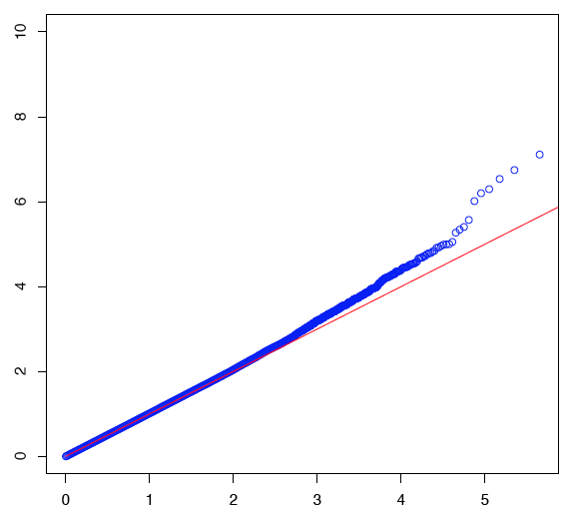
Standard mapping of H3K27ac QTLs with 10 Individuals
10
QQ Plot for H3K27ac
8
null
expectation
0 QTLs @ FDR 10%
6
linear model
p-values
-log10 observed p-values
4
2
0
0
1
2
3
4
5
-log10 expected p-values
Notes:
These are the results from performing this test on H3K27ac peaks across the genome.
This is a quantile-quantile plot that shows the ranked -log10 p-values on the Y-axis compared to the -log10 p-values expected under the null hypothesis.
Using this approach there is only a slight enrichment of SNPs with low P-values and no significant SNPs at a false discovery rate of 10%

Slide 83
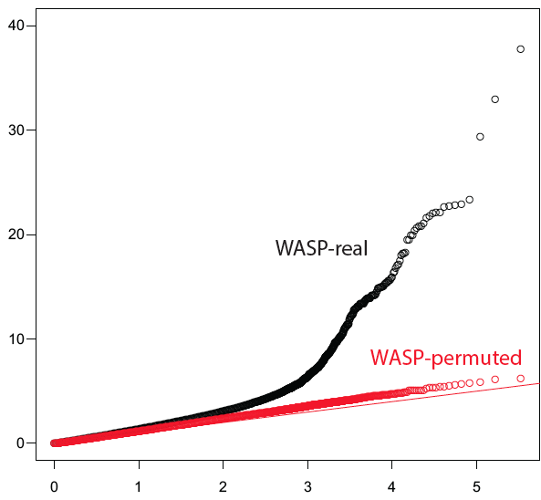
Combined Haplotype Test Mapping of H3K27ac QTLs
40
QQ Plot for H3K27ac
2426 QTLs @ FDR 10%
30
20
-log10 observed p-values
H3K27ac
peaks
10
Permuted
0
0
1
2
3
4
5
-log10 expected p-values
van de Geijn*, McVicker*, et al. 2015
Notes:
This QQ plot shows the results of applying the combined haplotype test genome-wide to H3K27ac peaks.
Using this test there is a large enrichment of SNPs with low p-values, and we can identify 335 distinct QTLs at a false-discovery rate of 10% (or 730 at a less stringent FDR threshold of 20%).
Interestingly if we look at dsQTLs we see that these are more enriched for low p-values than typical peaks, again indicating that multiple molecular phenotypes often occur together.

Slide 84
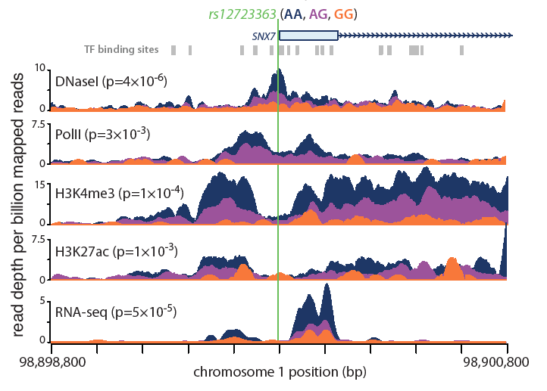
Example of a histone mark QTL
McVicker*, van de Geijn* et al. 2013
Notes:
Here is an example of what one of these QTLs look like.
This is an H3K4me3 QTL that is most strongly associated with this SNP that falls within the promoter of the gene SNX7.
In this track I’m showing the mean read depth for H3K4me3. The individuals have been colored and grouped by the genotype of this SNP.
Individuals with the AA genotype are colored in dark blue, and have much higher numbers of mapped reads across this region compared to heterozygous individuals (colored in purple) and individuals who are homozygous for GG (colored in orange).

Slide 85
Example of a histone mark QTL
McVicker*, van de Geijn* et al. 2013
Notes:
In addition to being associated with H3K4me3, this genetic variant is also associated with H3K27ac across the promoter region.

Slide 86
Example of a histone mark QTL
McVicker*, van de Geijn* et al. 2013
Notes:
And this SNP is also associated with RNA-seq reads, in other words it is an eQTL

Slide 87
Example of a histone mark QTL
McVicker*, van de Geijn* et al. 2013
Notes:
Finally it is also associated with RNA polymerase 2 binding and with DNase sensitivity.
In general, many of the histone mark QTLs look like this where multiple molecular traits are correlated with a single genetic variant.
This shows that these molecular traits are closely connected, and that the same processes that affect gene regulation often affect multiple aspects of chromatin state.

Slide 88
DNA methylation QTLs
Banovich et al. 2014

Slide 89
DNA Methylation QTLs are often also DNase sensitivity QTLs
-log10 observed p-values
-log10 expected p-values
Banovich et al. 2014

Slide 90
Histone mark QTLs are often DNA methylation QTLs
-log10 observed p-values
-log10 expected p-values
Banovich et al. 2014

Slide 91
Li et al. 2016

Slide 92
Sharing of regulatory QTLs
Li et al. 2016

Slide 93
Discussion
How can molecular traits be connected to organismal traits?
What can we learn from molecular traits?

Slide 94
Intersecting eQTLs with GWAS
Shared
CD4+ T cell
specific
CD4+ T cell
specific
Raj et al. 2014

Slide 95
GWAS enrichment in cell-type specific annotations
Finucane et al. 2015

Slide 96
Finucane et al. 2015

Slide 97
Summary
Many molecular traits can be associated with genetic variants
Molecular QTLs can reveal mechanism underlying organismal traits
Smaller samples are needed to map molecular QTLs that organismal traits
Genetic associations are challenging to interpret
Notes:
To summarize, what I told you about today.
I talked about how multiple aspects of chromatin can be treated as a molecular trait.
I described WASP, which is a powerful method for discovering molecular QTLs.
WASP can be used to discover 1000s of genetic variants that are associated with chromatin traits such as histone modification.
And we can use genetic variation as a means to discover transcription factors that are important for histone modification.

